Slide 1
Ruby language

Slide 2
Language Development
Since 2003, it has been rapidly gaining new supporters, mainly due to the popular framework for creating web applications called Ruby on Rails, created by a group of programmers led by David Heinemeier Hansson.
In 2005, according to statistics from Amazon.com, the two most popular books on Ruby and Ruby on Rails were the top-sellers in the Programming category.

Slide 3

Language Development
On January 30, 2009, version 1.9.1 was released. She improved the Unicode support and interpreter performance thanks to the introduction of a new mechanism called YARV (Yet Another Ruby VM).

Slide 4
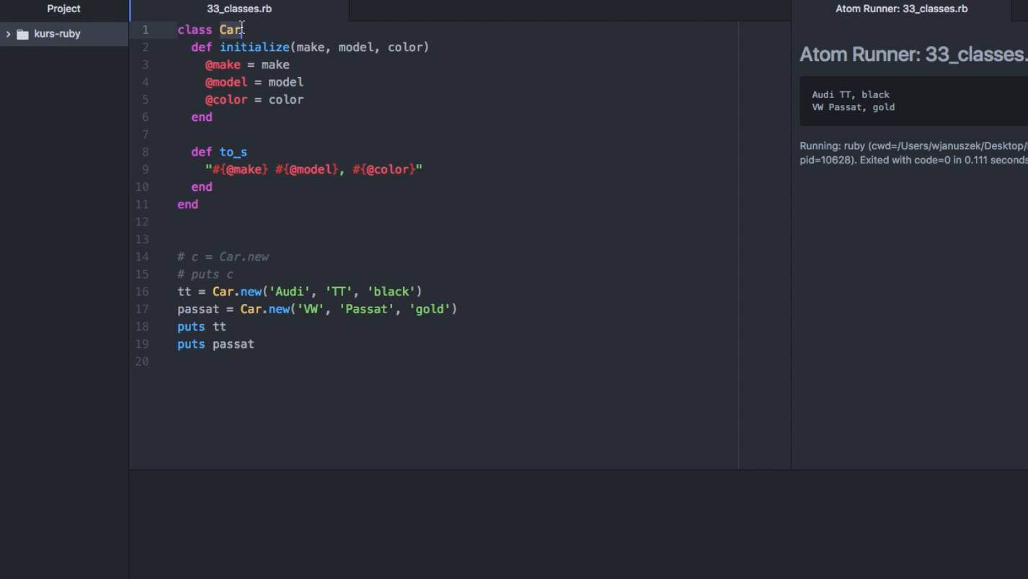
Exemplary Ruby Code

Slide 5
Thanks For Wathing B)

